Slide 1

ASK Modulation and FDM Multiplexing and De-MuLTIPLEXING OF DIGITAL SIGNALS
Course: Data Communication Section-D ||GROUP-5
Presented by:
S. M. RASEL 22-48039-2
MD. ABRAR RAFID SHARIAR 22-48055-2
MD. ABU SUFIAN SHOWROV 22-48735-3
NAYEEM ISLAM NAYAN 23-51350-1

Slide 2
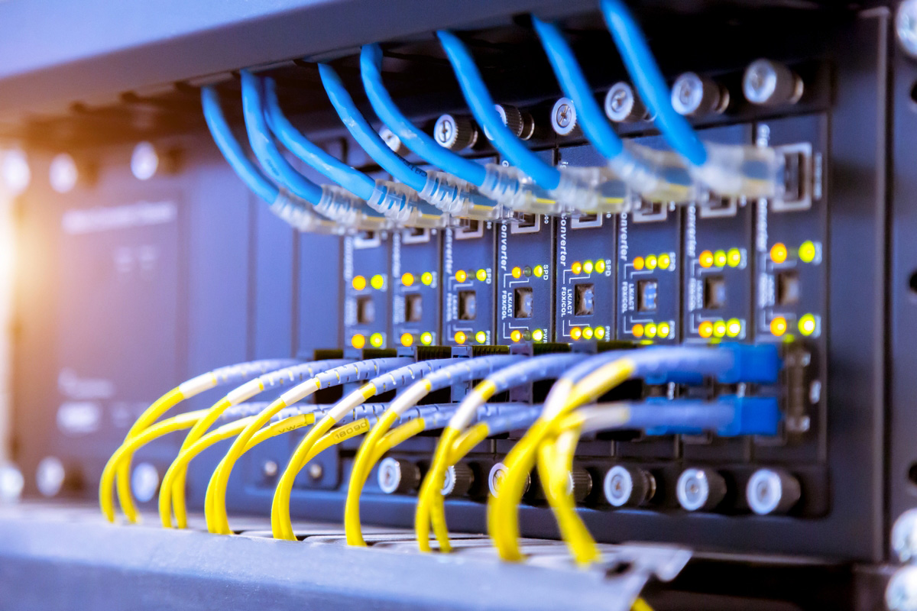
Objectives
Convert binary data (x₁ & x₂) to analog using ASK.
Multiplex analog signals using FDM.
De-multiplex & demodulate to recover digital data.

Slide 3
Procedure
Generate binary data x₁ & x₂.
Modulate using ASK (MATLAB).
Apply FDM to combine signals.
Transmit composite signal.
De-multiplex using bandpass filters.
Demodulate and recover digital signals.
Verify with original.

Slide 4
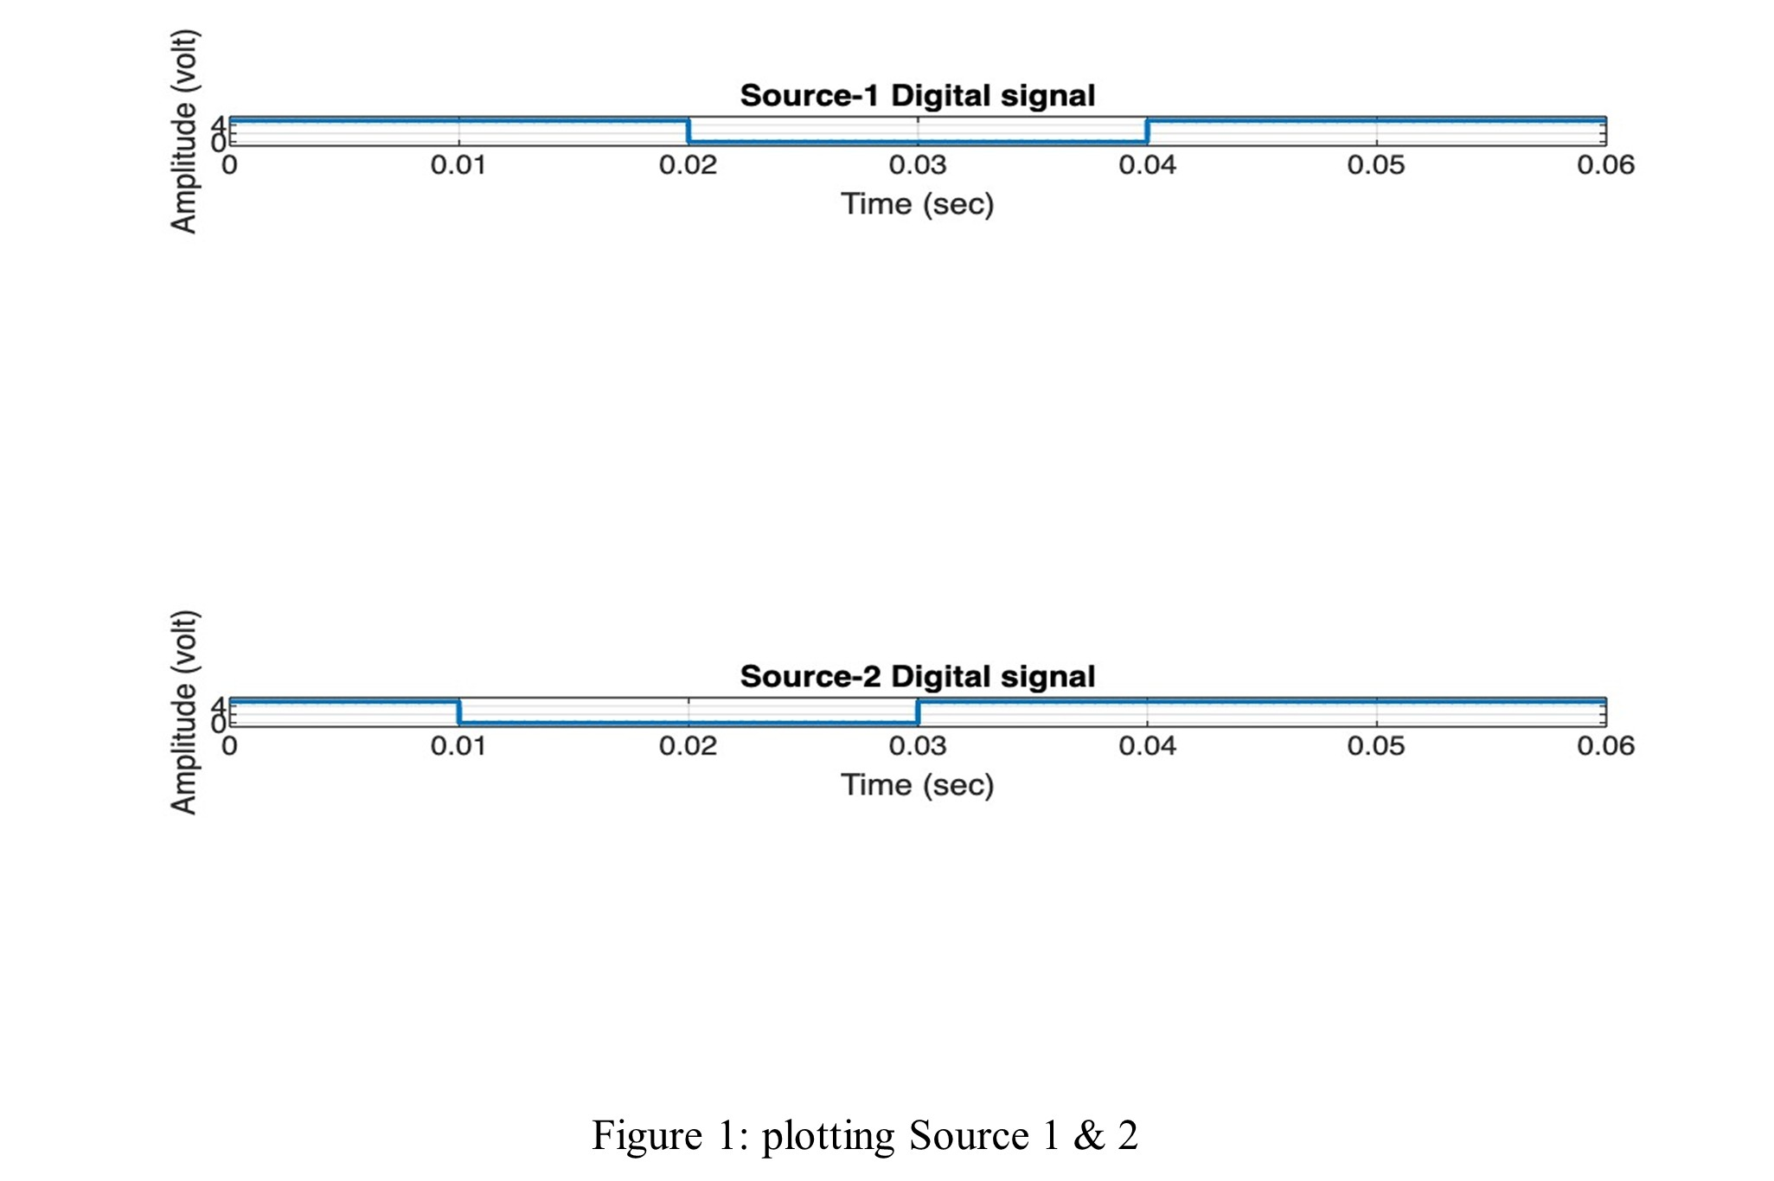
MATLAB Simulation – Digital Signals
s1 = [1 1 0 0 1 1];
s2 = [1 0 0 1 1 1];

Slide 5
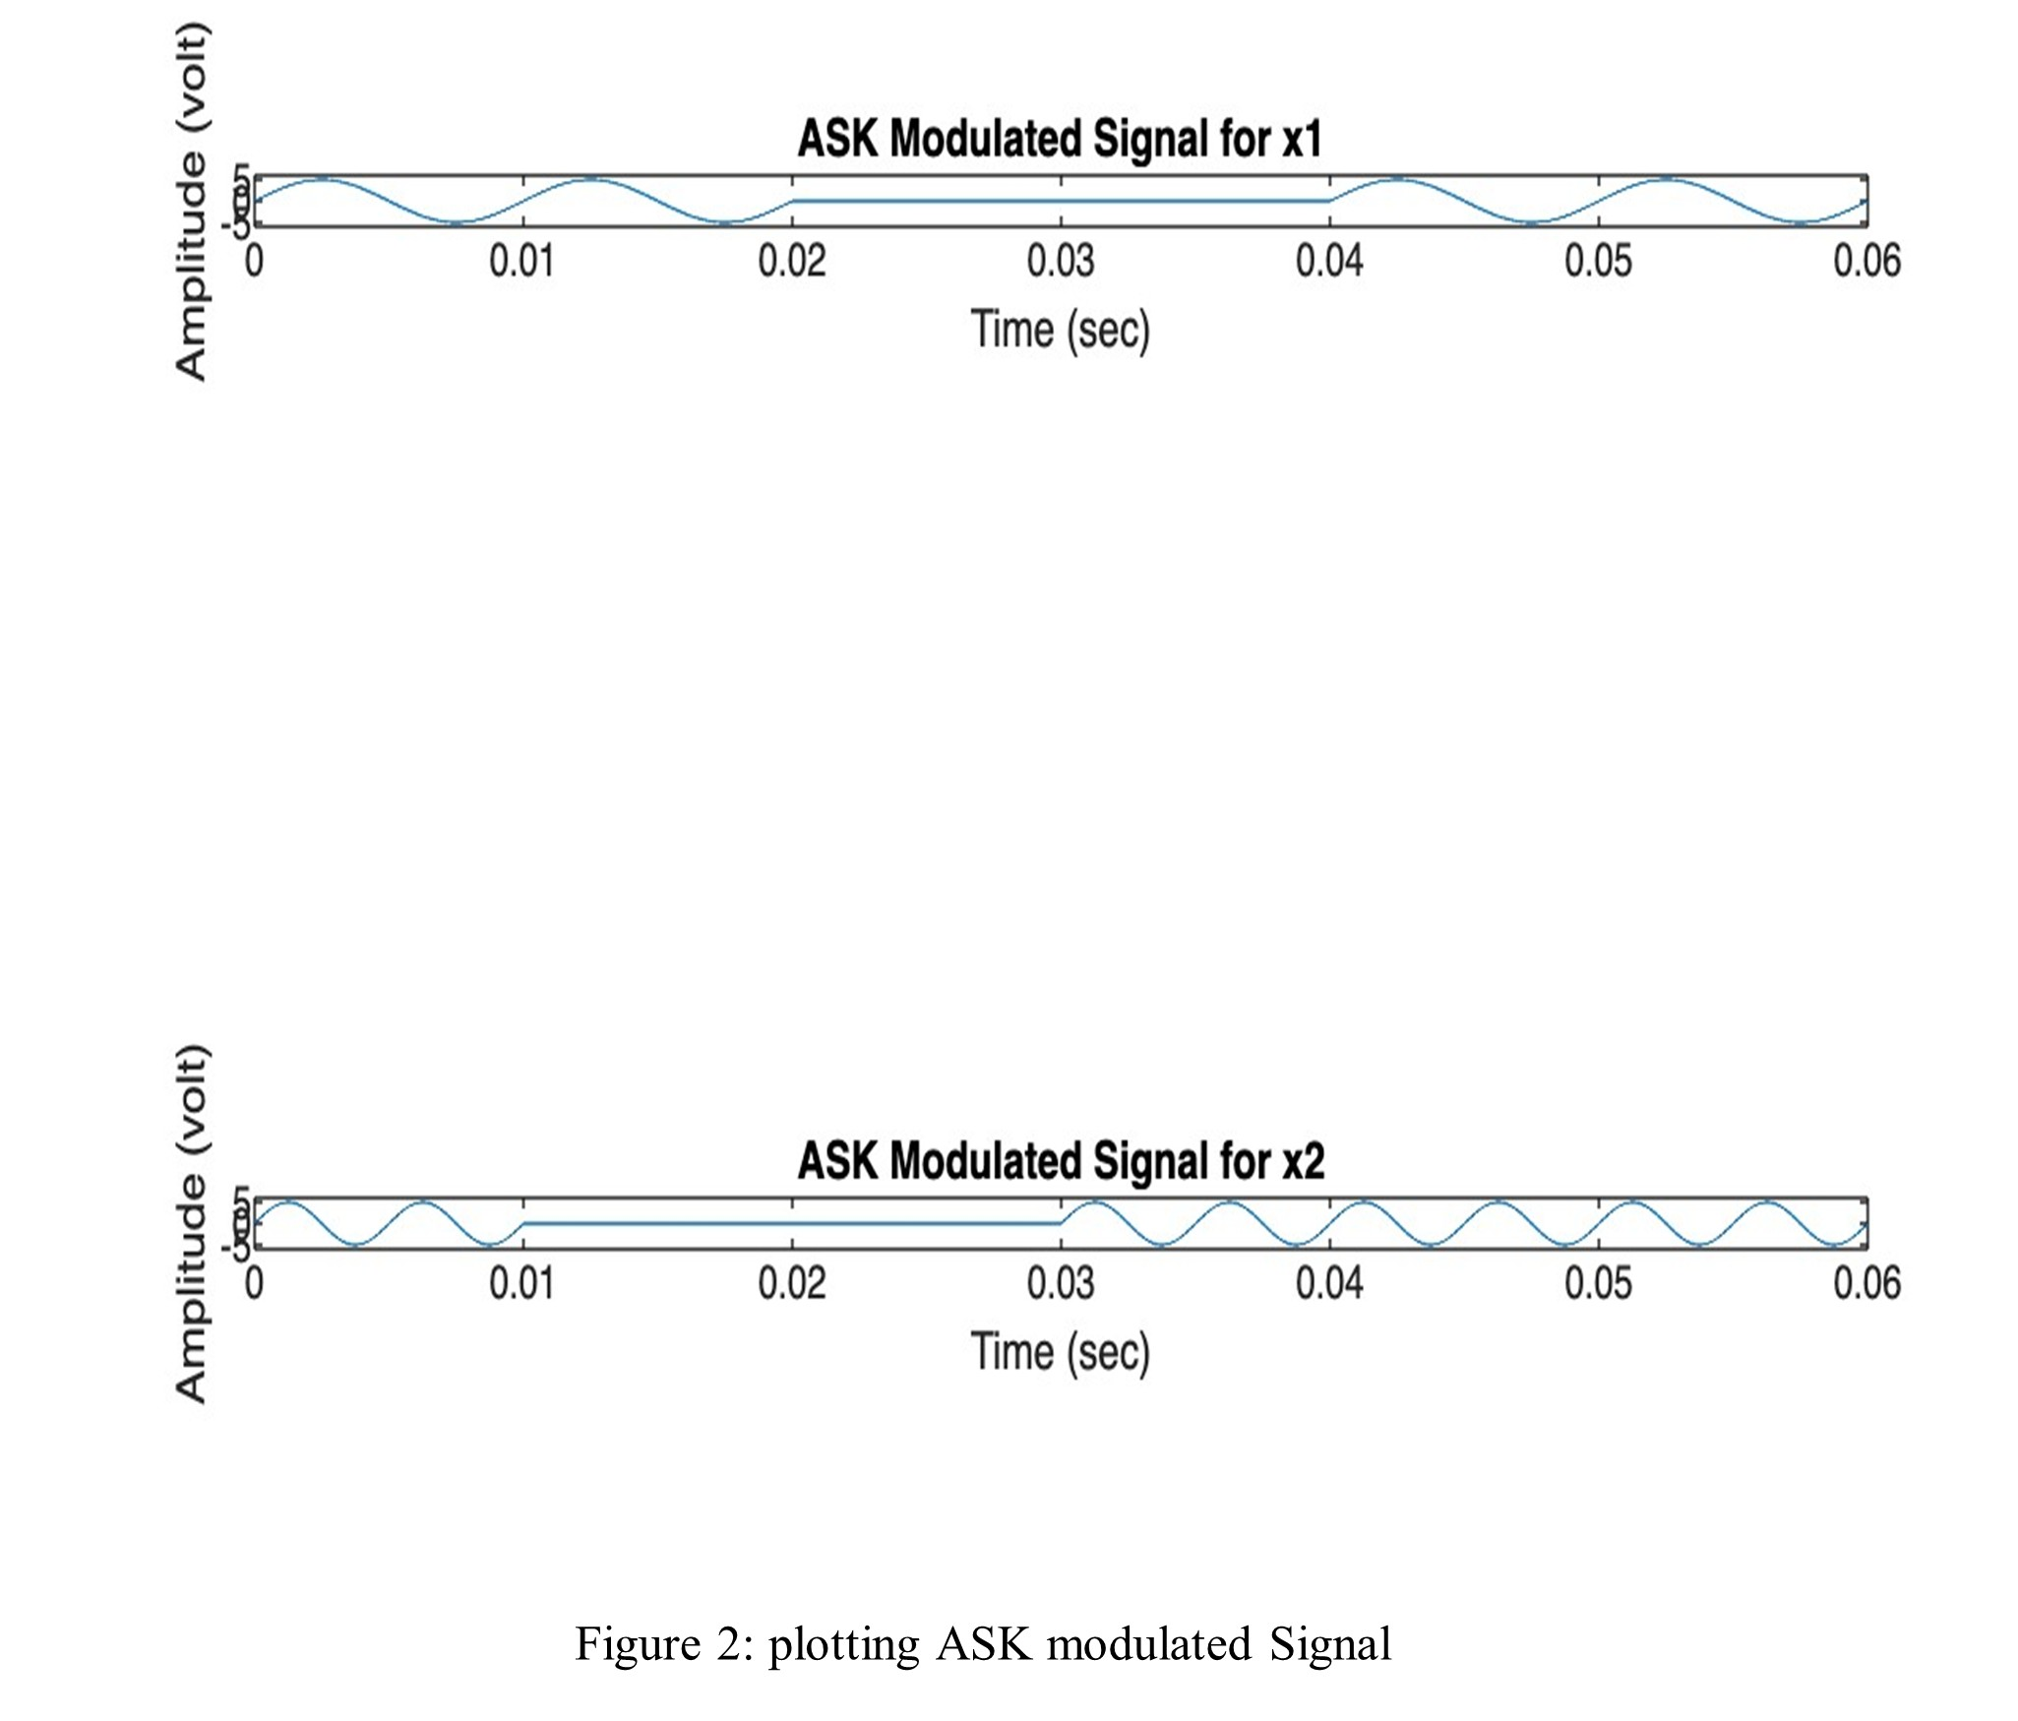
MATLAB Simulation – ASK Modulated Signals
ask_sig1 = A * sin(2 * pi * f1 * t) when s1(i) == 1
ask_sig2 = A * sin(2 * pi * f2 * t) when s2(i) == 1

Slide 6
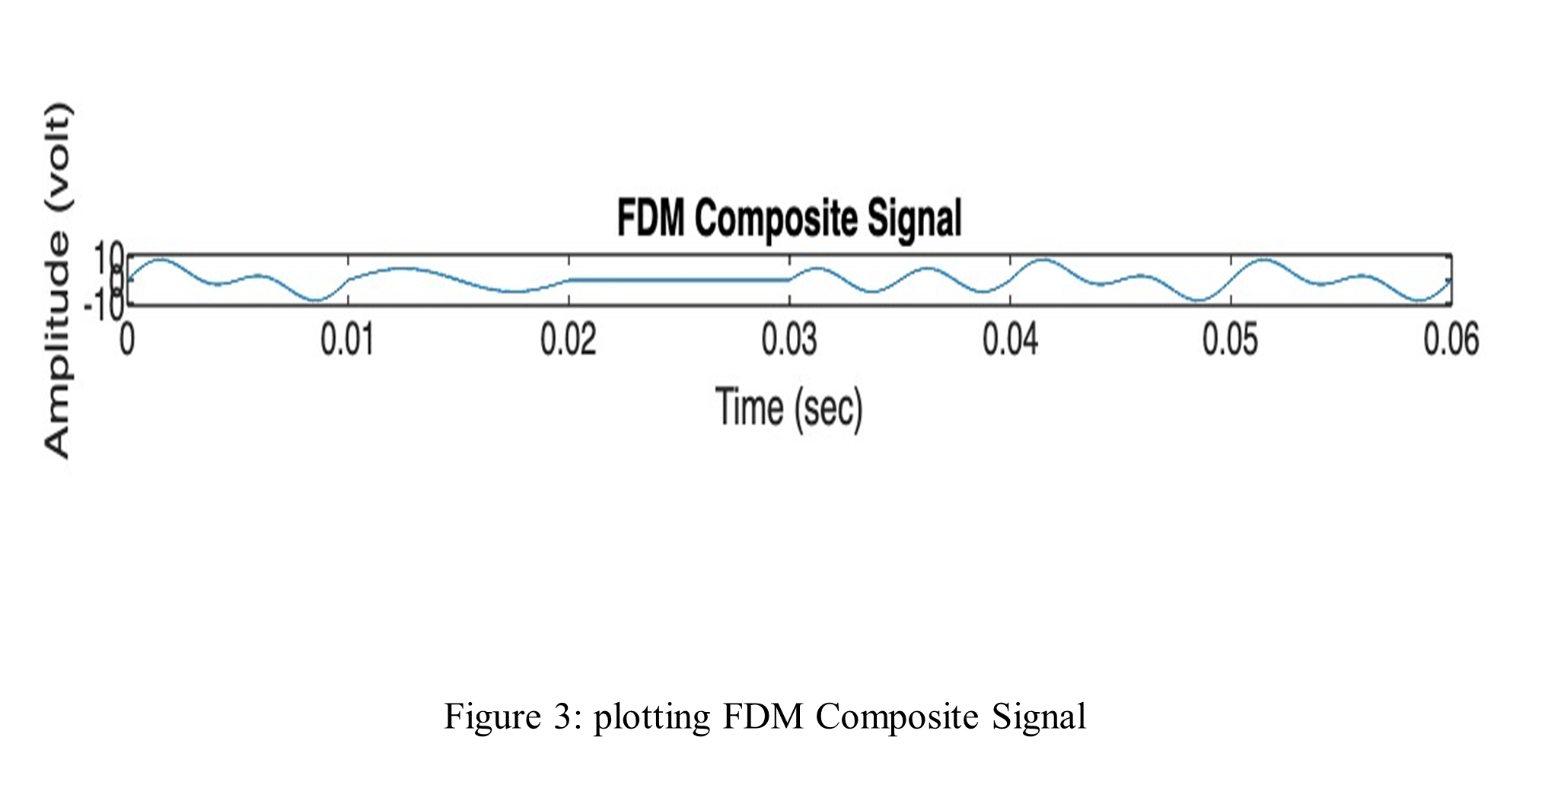
MATLAB Simulation – FDM Composite Signal
s = ask_sig1 + ask_sig2;

Slide 7
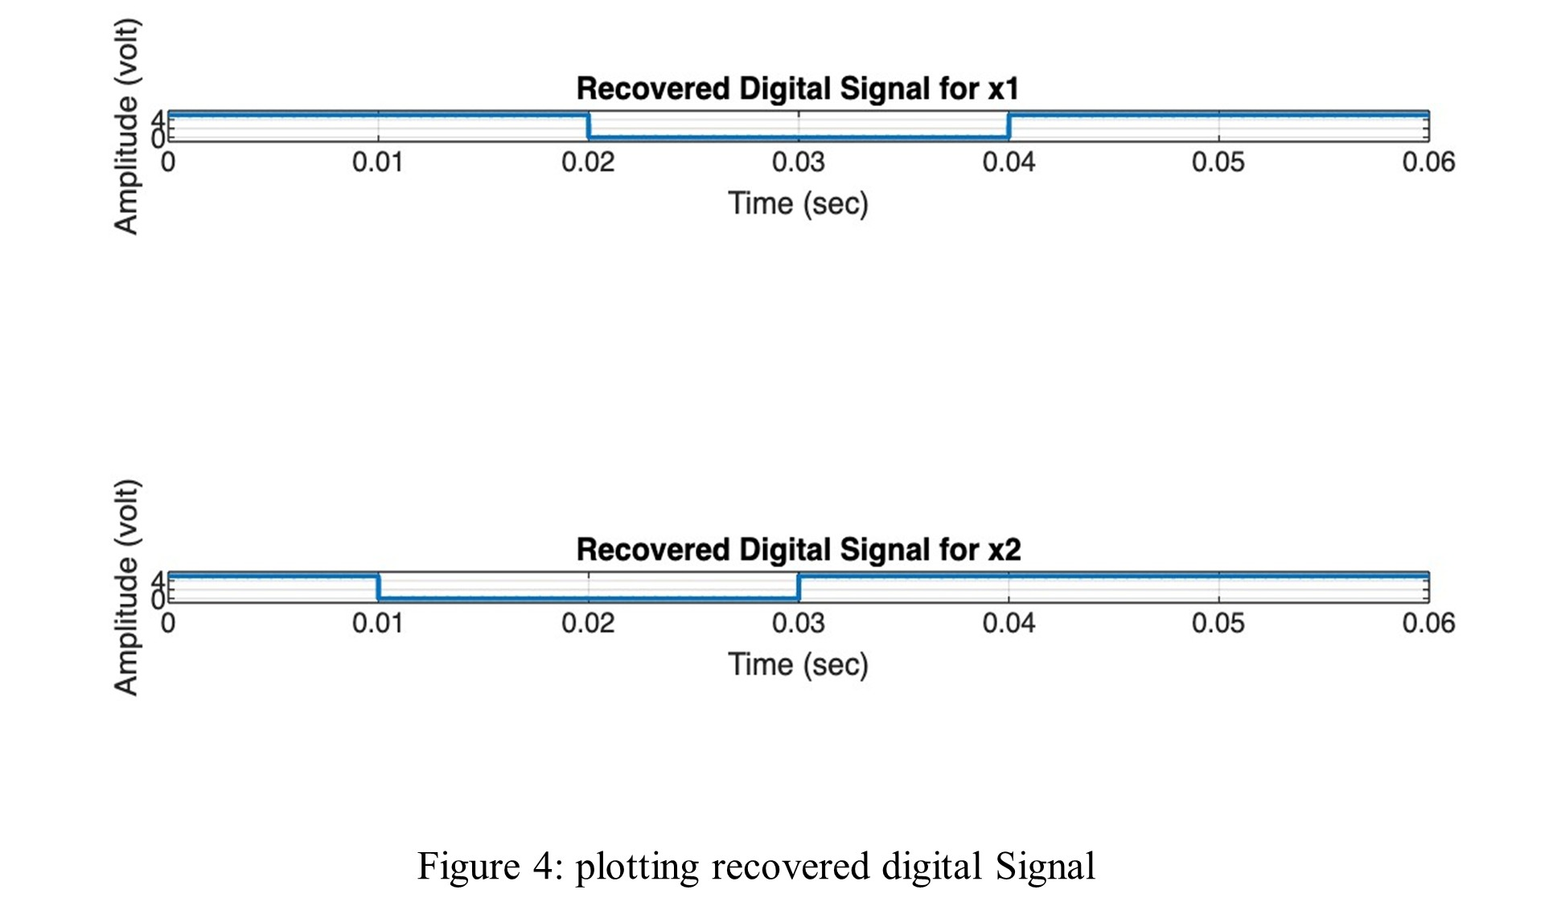
MATLAB Simulation–Recovered Signals
demod_sig = abs(ask_sig)
threshold = A / 2;
recov_s = demod_sig > threshold;

Slide 8

Societal Impact
Society: Enables IoT, telemedicine,
e-learning.
Health: Clear communication in medical devices.
Safety: Enhances disaster management & emergency systems.
Culture: Global connectivity, cultural preservation.

Slide 9
Discussion
This experiment successfully demonstrated the use of ASK and FDM for transmitting and recovering digital signals. The binary data streams were accurately modulated, multiplexed, transmitted, and demodulated with minimal distortion.
Key challenges included precise carrier frequency selection and threshold setting for demodulation. Although effective in simulation, ASK is noise-sensitive, and FDM requires careful frequency spacing. Overall, the lab proved the feasibility of these techniques under ideal conditions and highlighted areas for future improvement like noise handling and advanced modulation methods.

Slide 10
Conclusion
Success: Effective use of ASK & FDM.
Advantages: Accurate signal recovery, simultaneous transmission.
Limitations: ASK sensitive to noise, FDM needs clean separation.
Future Work: Include noise modeling, explore better modulation schemes.

Slide 11
THANK YOU

